Slide 1

Record High Prices
Modeling Vinyl Resales
Kari Davis

Slide 2
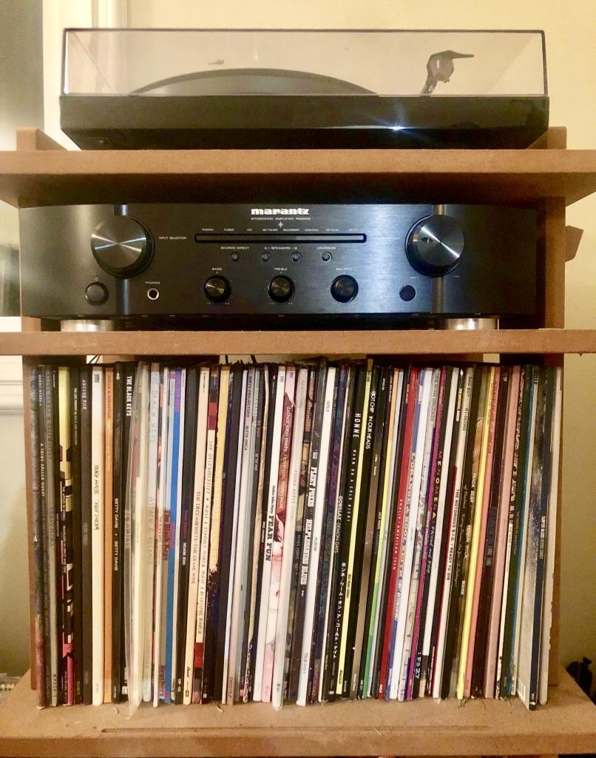
Introduction
Question:
How can I keep the value of my vinyl collection as high as possible?
Goal:
Determine the features which are most important to resale price.

Slide 3
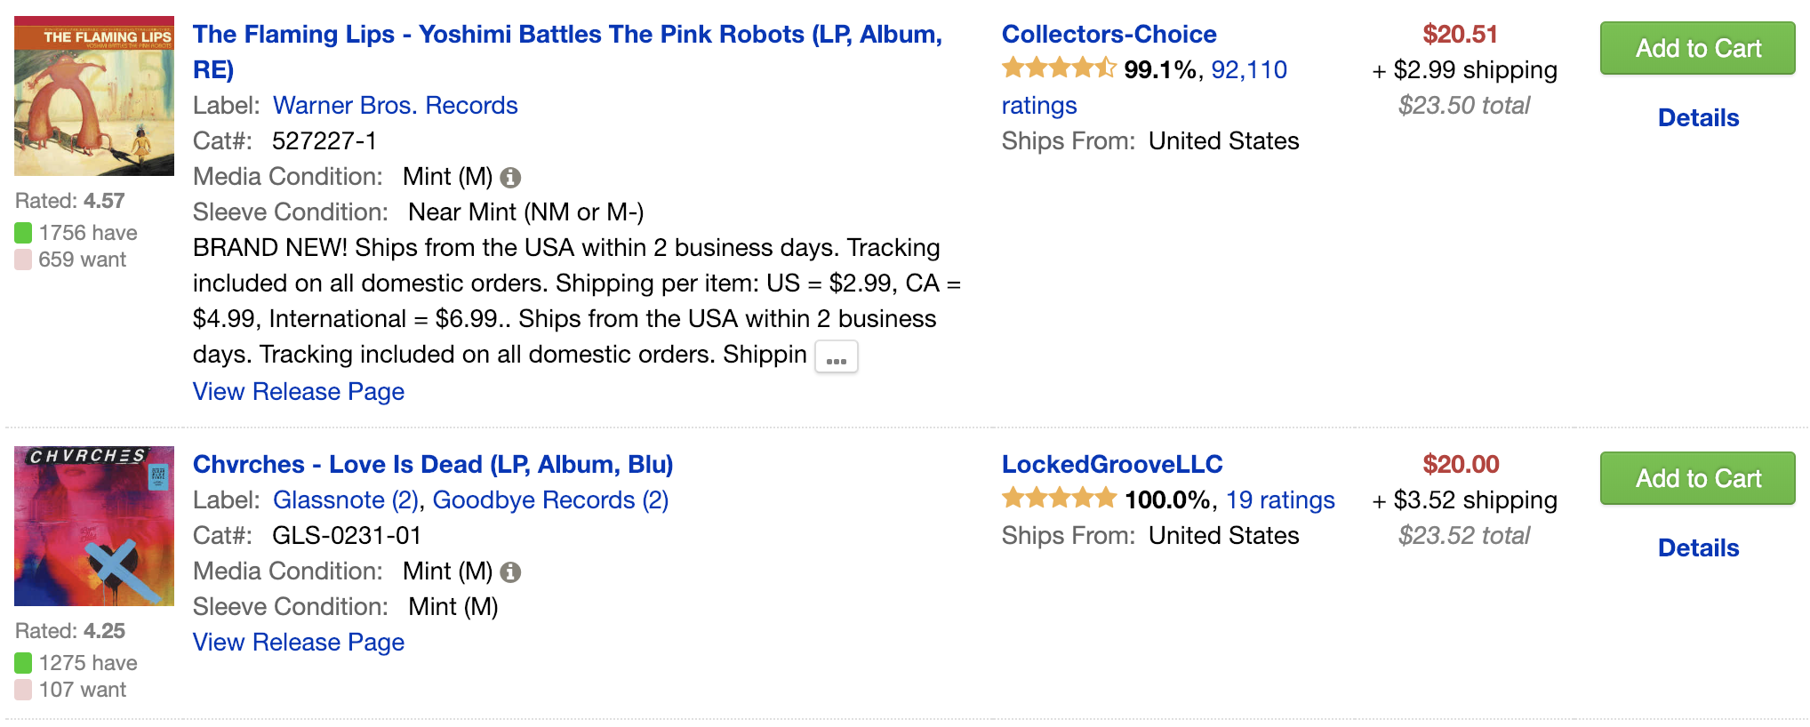


Data Gathering

Slide 4
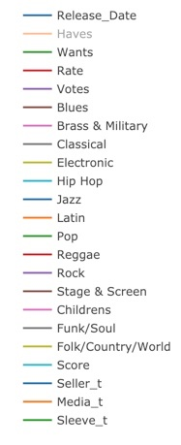
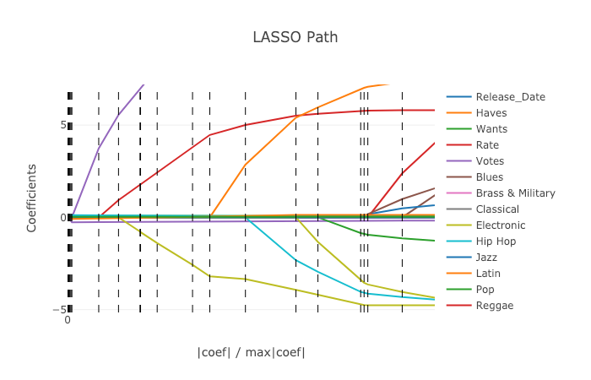
Features
Notes:
3 highest positive correlations with price: Rock Music, # Wants, Album Rating
Highest negative correlations: Release Date, Electronic Music

Slide 5

Modeling
Model | R^2 | Adj R^2
Linear Regression | 0.224 | 0.221
Ridge Regularization | 0.204 | 0.201
Lasso Regularization | 0.190 | 0.187

Slide 6
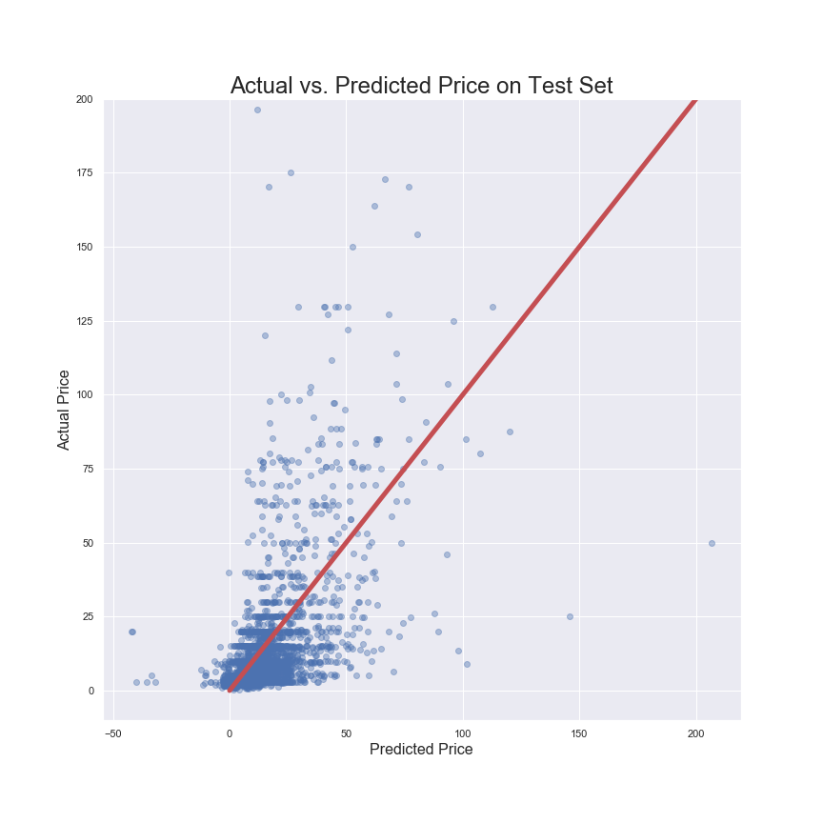
Results
R^2 | 0.2482
Adj R^2 | 0.2379
RMSE | 20.03
Future Work:
Prediction with other models
Format Comparison

Slide 7
Thank you!

